Slide 1
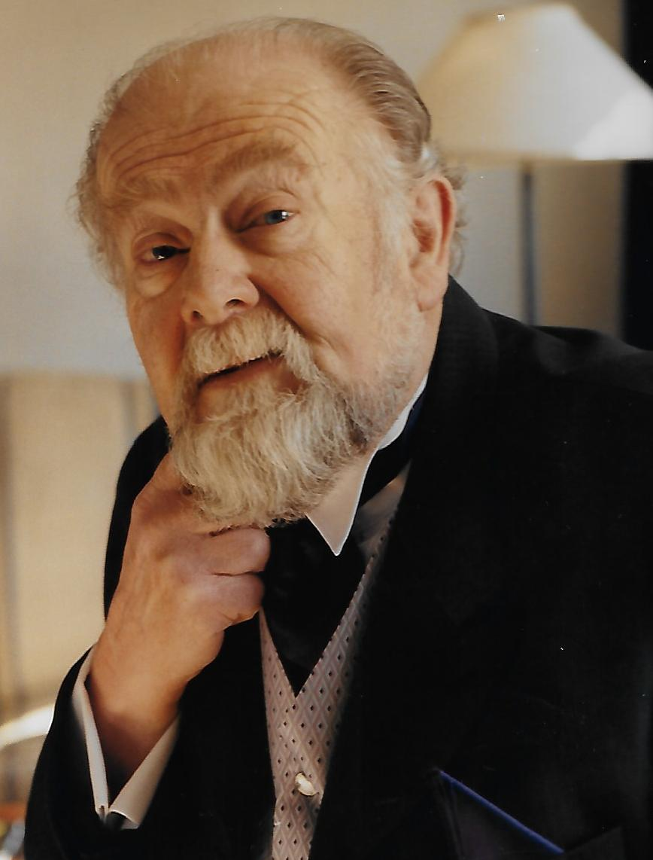
DAVID SPACKMAN
NDP, BVSc, MRCVS
1938 - 2022
Secretary,
UKEP & LIB

Slide 2
A LOOK AT DAVID’S LIFE
After working in the RAF, David, in 1961 returned to find his Father rearing pullets for 8 shillings and selling them for 18 and decided that this sounded like a capital enterprise. He managed to land a job with renowned free-range pedigree Leghorn breeder, Rosie Tyler, followed by a move to Reading University after 2 years, to carry out poultry research, whilst living at an experimental farm in Shinfield.
This continued until 1965, when he was accepted on a National Diploma in Poultry course at the National Institute for Poultry Husbandry at Harper Adams College in Shropshire.
Having graduated, with the Gerard Kitson Prize, National Grossmith prize and Millers Mutual Prize, David gained employment as a Poultry Advisor in Wales.
In 1972, David was selected to retrain as a Veterinary Surgeon, attending Bristol University and the Langford site for the practical part of the degree.
After graduating in 1977, the family moved near Woking, in Surrey, where David took up a position at the Central Veterinary Laboratory in Weybridge, as well as numerous consultancy positions working abroad in locations including Hungary, India, Saudi Arabia and the USA. David travelled widely, but also became a partner in a Veterinary practice in Wokingham, Berkshire, as well as working at the Guide Dogs for the Blind Training Centre in Wokingham and in the television industry, overseeing the care of animals in adverts and on television programmes.
David quickly found himself at the forefront of the poultry industry, and in 1988 was heavily involved as an expert witness in the “Salmonella in Eggs” scandal that engulfed egg farmers and the government alike, trying to reassure and calm, as was his manner.
David set up in business as a Poultry Consultant, with many of the largest enterprises in the UK (and further afield) as well as some much smaller and very “interesting” ones!
He also undertook work on some of the Royal Estates, including Windsor, treating and advising on the care of the Royal pheasants and chickens. How ironic and sad that HM Queen Elizabeth II should also pass away only 2 weeks after David!
Dave and his Son-in-Law Rob, successfully undertook a major project with Australian Poultry Keepers to help re-populate and introduce new rare/pure breed chickens, from their breeding and development programme near Aylesbury. Others in the UK had been approached to do this, but Dave was the only one who believed it could be done and made it happen.
The Australian poultry keepers are hugely grateful and have the David Spackman Cup for Best of Show awarded at their annual event. It was something he was immensely proud of and happy to prove the doubters wrong!
In 2018, David was presented with a “Lifetime Achievement Award” from the British Free Range Egg Producers Association, and whilst truly honoured at this recognition, David’s first response was “Oh sh*t, they only do this kind of thing when they think you’re on your way out!”
He, however, proved this fact to be totally untrue, by wholeheartedly continuing with his own Consultancy work, as well as being Secretary for the United Kingdom Egg Producers Association and Laid in Britain Ltd, for a further 4 years. Mobility issues and a global pandemic wouldn’t dampen his enthusiasm or commitment to his work. Whilst the legs might have been slightly ‘challenged’ of late, there was nothing wrong with his brain!
Even in the hospital, David worried about how to explain to members that he wouldn’t be able to write anything for the Hotwire that month – his lifetime dedication to his work knew no limits!

Slide 3
FAMILY THANKS
Thank You to those of you who managed to attend David’s funeral on 20th September.
Those who attended, as well as many who were unable to, were kind enough to send tributes in for us to cherish.
This presentation includes just a small, anonymous, selection from those that we received, and we wanted to share them with you, the UKEP & LIB members.
David would be very humbled at the wonderfully kind sentiments conveyed by you all, as are we. Thank You.
For those of you who wish to, we thought a fitting tribute to someone who devoted such a huge part of their life to the care of all those involved in the poultry industry, would be to please…
“Remember David”
on:
World Egg Day, Friday 14th October 2022

Slide 4
YOUR THOUGHTS AND MEMORIES
I feel very lucky to have had the pleasure of working with David and the chickens.
~
The most knowledgeable poultry specialist and a voice of reason over so many years.
~
A true gentleman and champion of the independent egg farmer. He will be greatly missed.
~
Our whole staff share in the sorrow at losing David. He was a wonderful man and a true friend. We will truly miss him.
~
Dave has been an amazing man of learning and compassion and although he will be sorely missed, he will be remembered with much love, pride and respect.
~
An utterly wonderful man!
~

Slide 5
YOUR THOUGHTS AND MEMORIES
I joined the UKEPRA Committee in the nineties and recall David as the calm steady voice of reason as he made comments on various matters and topics. He was always there with a kind word of support and I will remember him as an absolute gentleman.
~
David has always been there for me over the years. His completely unselfish support and assistance has been such a great help in my life and I for one am going to miss this very fine unselfish man. He will leave a vast gap in my life.
~
I have known David since the 1970s, when David was a regular on the speaker circuit. Always spoke straight and with common sense. Still, in later years when David stopped visiting, it was always re-assuring to speak to him. Just communicated the news to another producer. His reply to me: “An eminently sensible Vet and great character. Will be much missed.” That really sums up David to us clients.
~
The best Vet ever. Your work will live on long after you’ve passed. You always had time to give and time to care. Thank You so much for the knowledge you have given me.
~

Slide 6
YOUR THOUGHTS AND MEMORIES
I have known David for many years, firstly as a Veterinary Advisor to UKEPRA, and then as the person who took on the mantle of running both UKEPRA while developing the Laid in Britain scheme to what it is today. He will be remembered more widely by the entire UK Poultry Industry as one of the leading Veterinary experts in his field. I will remember the huge effort David and his team have put in to finally getting the Food Standards Agency to accepting Laid in Britain as an equal to the Lion Code. On a personal note I have always had the greatest respect and fondness for a man who has done so much for independent egg producers like myself. He will be greatly missed.
~
I’m sorry to hear of the passing of David. He was a great man, an excellent Vet and friend. He will be very much missed throughout the Poultry Industry.
~
I had the pleasure of working with David at various points throughout my time in Laying hens. Having come initially from the Dairy industry, David was a huge help to me, always patient and willing to explain things to me, acting as a true mentor.
~

Slide 7
YOUR THOUGHTS AND MEMORIES
David was a larger-than-life character in so many ways. I have had the privilege of knowing him throughout my professional career, well over 45 years.
I first came across him as a “retread” – a MAFF employee identified as a high-flyer worthy of retraining as a Vet under government sponsorship, as long as he remained within the Ministry. A few of his contemporaries reneged on the deal after qualifying, but David stuck to it, having started with the nickname of “Mr Egg” from the Egg Inspectorate, David then spent the rest of his career advising and caring for the humble egg, those who lay them, those who sell them and those who consume them. We have all benefitted from that.
I have always found him to be modest, yet forceful and with that rare ability to translate his massive knowledge and skills into something we can all learn from. He was at home with high science, but most importantly the appliance of science. He taught me a lot.
David’s passion for all he put his mind to was infectious.
He will be greatly missed. A life well lived.
~

Slide 8
OUR TRIBUTE TO DAVID
As you have read in the selection of memories of David, he worked tirelessly and passionately for everything he believed in, with great commitment and dedication.
He strongly believed in learning and that history had so much to teach us and how it greatly shaped our present and future.
With this in mind, we will now introduce a new feature to the monthly Hotwire, “Then & Now”, as we compare the market and egg industry today and in times to come, to how it was in previous years’ publications, reported and edited at the relevant time by David himself. We will keep his work alive by showing it’s relevance in the ever-evolving industry.
As we take up the baton in moving UKEP & LIB forwards, whilst knowing we can never match the unique knowledge and expertise David had for the industry, we will, however, try to remember all the valuable lessons he has taught us over the years and commit to honouring him, by endeavouring to keep up the fight for the Poultry Industry within the UK and global spaces.
He would undoubtedly tell us to “Crack on with confidence!”
DAVID – THANK YOU!

